Slide 1
The Basics of JavaScript and Animation

Slide 2
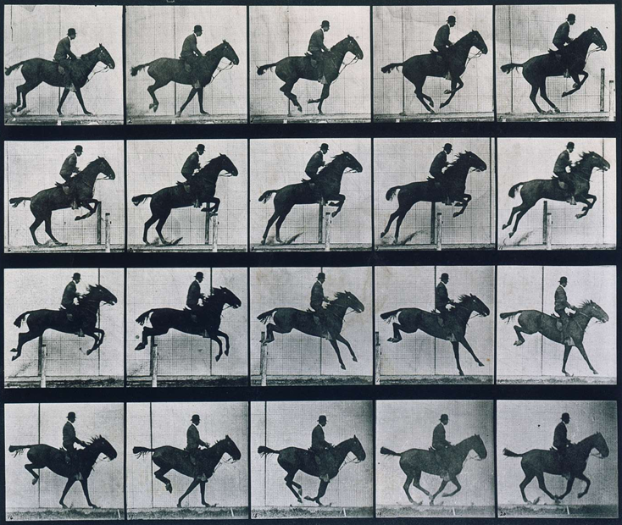
What is Animation?
Between 1878 and 1884 a very important question was resolved by Eadweard Muybridge

Slide 3
The Illusion of Movement
Draw a frame
Change the position
Draw the frame again
Too slow and we see the image jump
Fast enough and we see movement

Slide 4
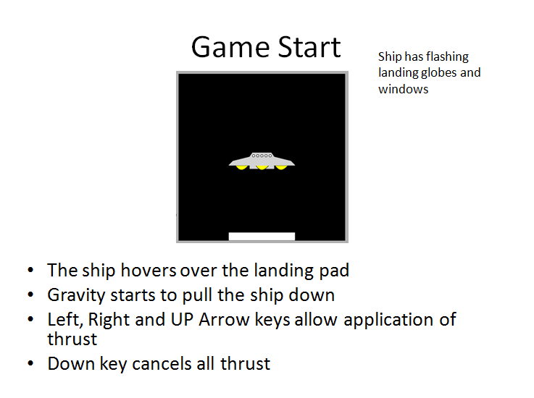
Space Lander Storyboard

Slide 5
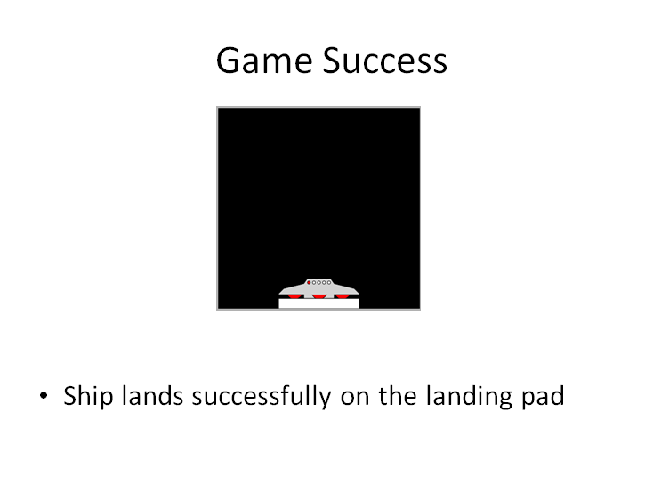
Game Success

Slide 6
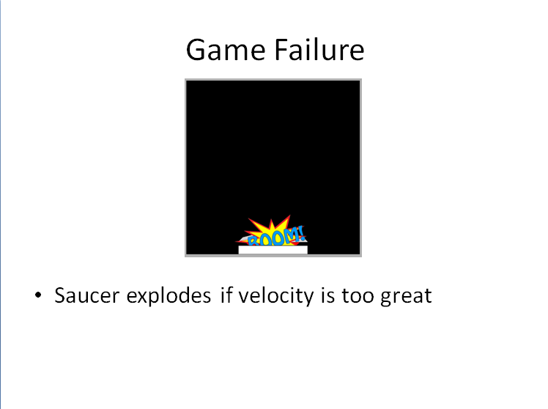
Game Failure

Slide 7
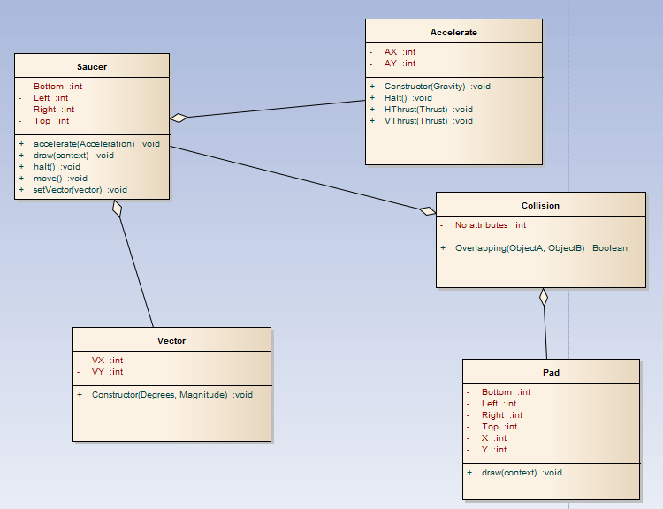
The Class Diagram
JavaScript is a fully object oriented language
Two types of classes
  Sprites (interface)
  Code (middle layer)

Slide 8

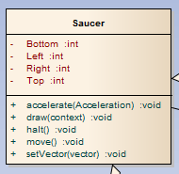
The Saucer Class

Slide 9

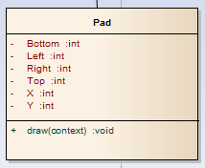
The Landing Pad

Slide 10
Other Classes
Accelerate – handles calculations related to gravity and acceleration
Collision – used to detect collisions between objects
Vector – used to apply a vector to a sprite
You will need to think about how to use these in your assignment

Slide 11

Let’s do Some Animation

